Slide 1
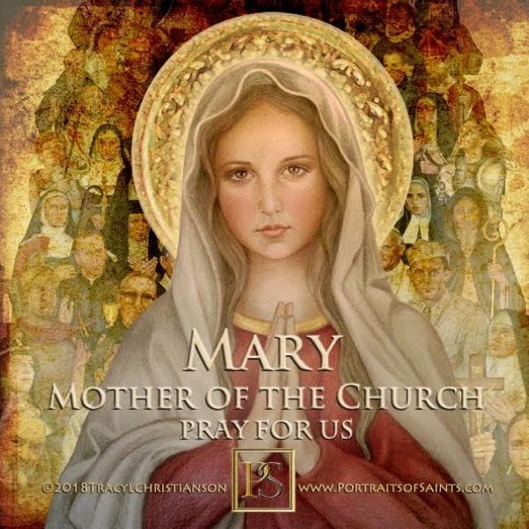
Mary Mother of the Church
May 24th 2021

Slide 2
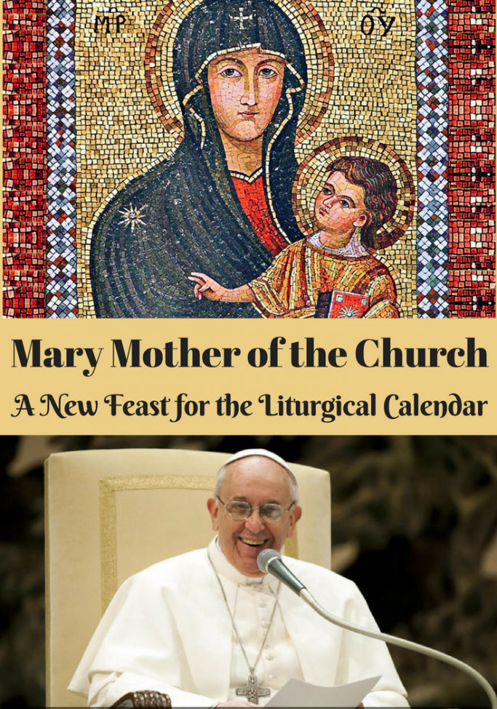

Slide 3
Mary Mother of the Church
The Church has honoured Mary Mother of God with various titles down through the centuries; titles such as Mother of Disciples, of the Faithful, of Believers, of all those who are reborn in Christ.
On 21 November 1964, at the conclusion of the Third Session of the Second Vatican Council, Pope Paul vi declared the Blessed Virgin Mary as “Mother of the Church, that is to say of all Christian people, the faithful as well as the pastors, who call her the most loving Mother”.
In 2018, Pope Francis added the Memorial (feast day) of the Blessed Virgin Mary, Mother of the Church to our Church calendar
We honor Mary as Mother of the Church on the day after Pentecost, reminding us that Mary was present with the disciples on Pentecost. Mary prayed with the first Christian community, awaiting the gift of the Holy Spirit for all believers. Mary prayed with them as the Holy Spirit descended.
And Mary, our dear Mother, continues to pray for us.

Slide 4
The “motherliness” of Mary
In the Gospel, Mary is always described as “the Mother of Jesus,” instead of “the Lady” or “the widow of Joseph”: her motherliness is emphasized throughout the Gospels, beginning with the Annunciation.
In his homily during Mass at the first celebration of this feast , Pope Francis said the first virtue of a mom is tenderness

Slide 5
The tenderness of a mom
The virtue that primarily distinguishes a woman, Pope Francis said, is tenderness, like the tenderness of Mary, when she “gave birth to her first-born son and wrapped Him in swaddling clothes, and laid Him in a manger.” She cared for Him, with meekness and humility, which are the great virtues of mothers.
Pope Francis encourages the Church to imitate the tenderness of a mother who knows the wisdom of silence, the wisdom of the gaze that knows compassion. A person who lives out this way of being a member of the Church, knows that he or she must go along the same path: a person who is gentle, tender, smiling, full of love

Slide 6
Prayer to Mary, Mother of the Church and Mother of our faith*
Mother, help our faith!
Open our ears to hear God’s word and to recognize his voice and call.
Awaken in us a desire to follow in his footsteps, to go forth from our own land and to receive his promise.
Help us to be touched by his love, that we may touch him in faith.
Help us to entrust ourselves fully to him and to believe in his love, especially at times of trial, beneath the shadow of the cross, when our faith is called to mature.
Sow in our faith the joy of the Risen One.
Remind us that those who believe are never alone.
Teach us to see all things with the eyes of Jesus, that he may be light for our path. And may this light of faith always increase in us.
*Prayer to Mary at the conclusion of the Encyclical Lumen Fidei (29 June 2013)

Slide 7
Prayers of Petition
1. We pray for the Church at this time, for Pope Francis and all Church Leaders. May our Church learn to reflect the tenderness and compassion of Mary our Mother. Lord hear us…….
2. We pray for an end to conflict and violence in our world especially in the Ukraine and the Middle East. Lord hear us…….
3. We pray that our world will be kinder, more equal, and more just in the post-covid era. Lord hear us…….
4. We pray for an end to world hunger, that charities such as Mary’s Meals are supported in their global quest to feed every hungry child. Lord hear us…….

Slide 8
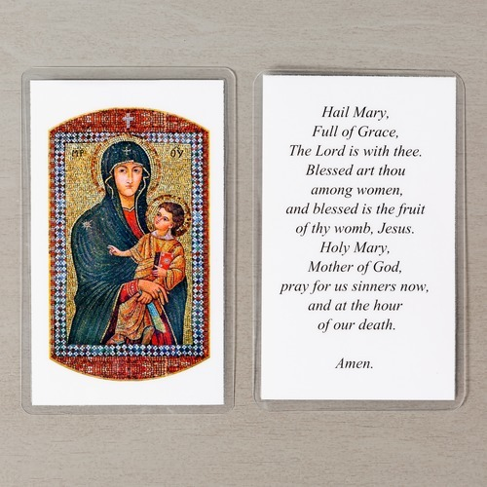
Together we pray…………..

