Slide 1
Graduation
Ideas and Discussions

Slide 2
Understanding the different context of each school
Entirely online
In person (students) and online (parents)
Service v's Mass
Diocesan Mass online
Regardless of this, the importance of acknowledging the importance of celebrating the end of 6th year for this group of students.

Slide 3
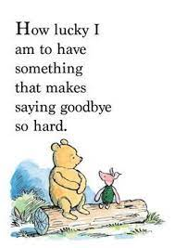
Suitable Themes
Importance of having a positive message

Slide 4
Suggested Themes
New Beginnings
Growing stronger together
The future is bright
It's the journey not the destination

Slide 5
Getting organised
Art and Decoration
The design of the mass/service booklet, class symbols, the preparation of the altar/space.
Music
Choosing appropriate hymns and music for the various parts of the mass; the choir
Prayers and Reflections
The welcome; penitential rite; the readings; the prayers of the faithful; communion reflection and the final blessing.
Procession
Planning the entrance, offertory and concluding processions.

Slide 6
Class Symbols to represent the theme

Slide 7
Sample Graduation Mass/Service Template

