Slide 1

Earth Our Home

Slide 2
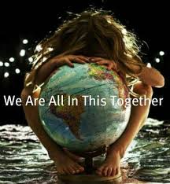

Slide 3
Early Humans
Homo habilis, the first human species to evolve, appeared on the Earth about 2.8 million years ago. These humans initiated the use of stone tools.
They were hunter-gatherers, and like all other species, they lived in close harmony with the earth.
Homo erectus appeared about 1.5 million years ago. These humans also were hunter-gatherers and learned how to domesticate fire. Over time they spread from Africa to distant China.
Homo neanderthalis evolved about 300,000 years ago. These humans were hunter gathers, and buried their dead with religious rituals.
Homo sapiens emerged about 200,000 years ago (now the only surviving human species). Homo sapiens people were hunter gathers until about 12,000 BCE when humans began to form settled communities.
Notes:
Marco Polo

Slide 4
The Magic Era
Early humans had no rational explanations for any of the natural phenomena that governed their lives. Everything was mysterious and magical.
Palaeontologists refer to this period in human history as the Magical Era. Everything was magic.
The religious practice of early humans combined ritual, mythology, spirituality, and magical thinking.
There was a shared belief among them that trees, rivers, plants and animals had a spiritual dimension. (Animism)
The whole environment was pulsating with the Divine Presence.

Slide 5
Early Humans & Earth
The religious beliefs of our ancestors encouraged a warm and respectful attitude towards the Earth.
The Earth was regarded as a mother figure and this was reflected in religious rituals and celebrations.
There were many gods and goddesses; they had responsibility for rivers and seas, forests, and mountains, sun and moon and stars.
All of creation exuded a Sacred Presence.
The sacred and the secular were interwoven in cultural practice across many societies and traditions.

Slide 6
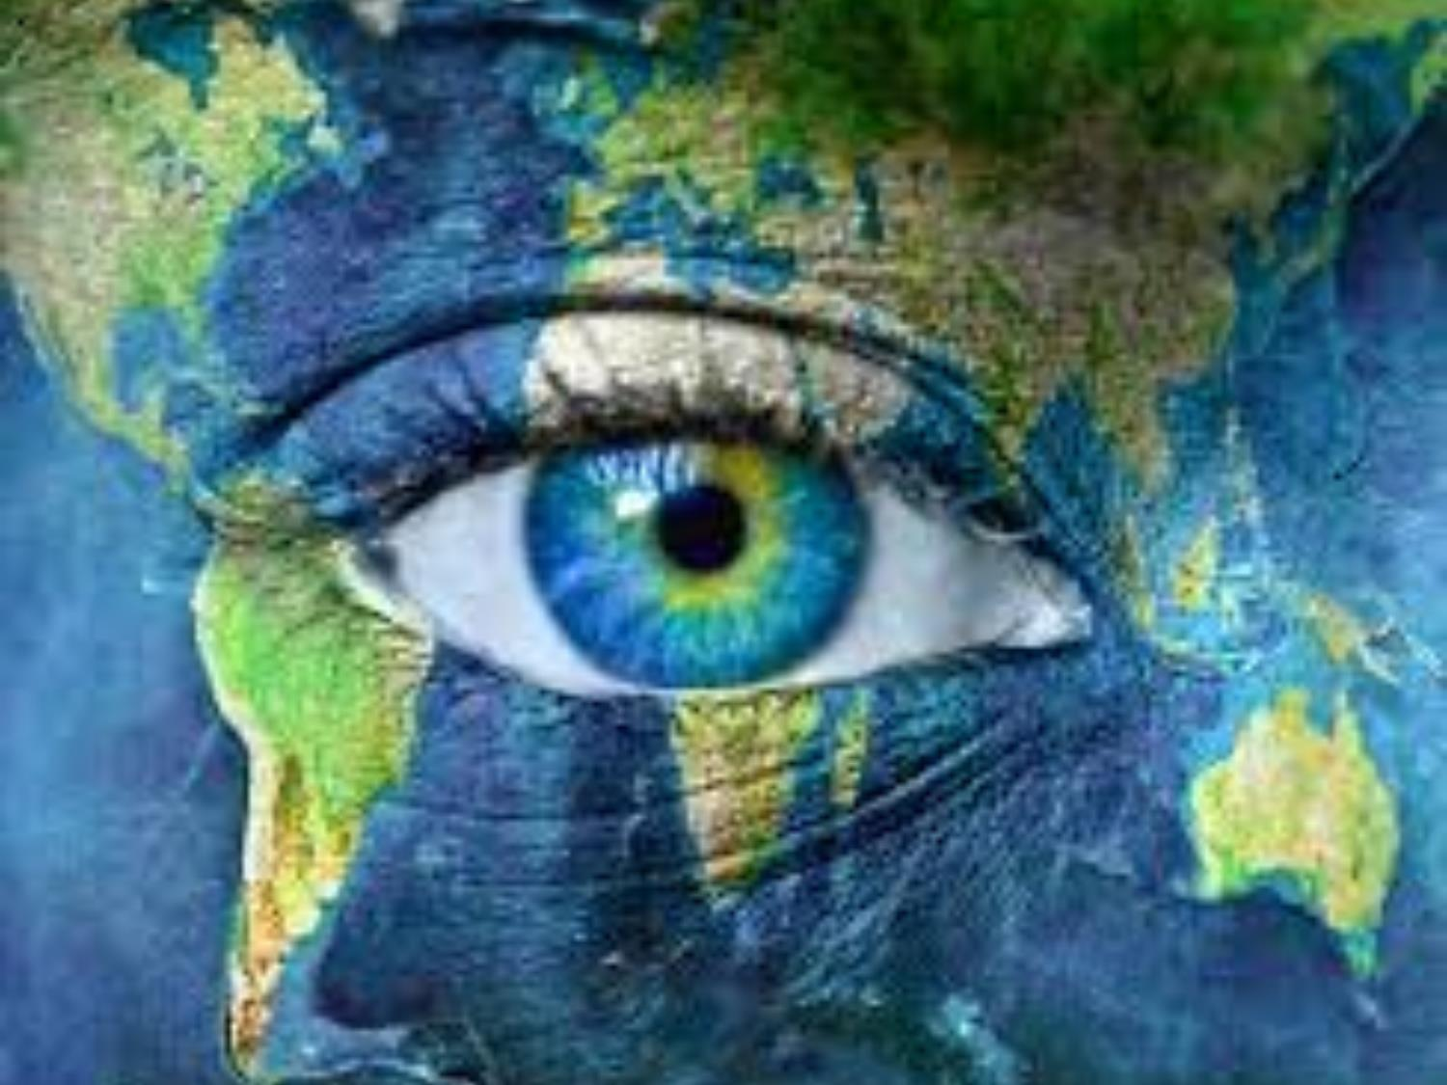
Mother Earth

Slide 7
Mother Goddess
As our ancient ancestors slowly awoke to the mystery of the world around them, they were filled with awe and wonder.
They were drawn to a belief in a Mysterious Power greater than themselves that transcended their world.
This mysterious power was experienced as maternal and caring, and came to be known in many cultures as the Mother Goddess.
This Mother Goddess was associated with nurturance, caring, fertility, life, energy, birth and rebirth.
Notes:
Animate Earth p. 41

Slide 8
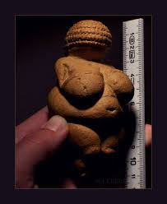
Willendorf Venus
The Venus of Willendorf is a 11 cm high statuette of a female figure estimated to have been made about 25,000 BCE.
It was found in 1908 during excavations conducted at a site near Willendorf, in Austria
It was carved from limestone that is not local to the area, and was tinted with red ochre. Religious ritual possibly.

Slide 9
Mother Goddess From Different Cultures
Greek → Gaia
Crete → Ariadne
Pre-Celtic → Danu
Celtic → Brigid
Egypt → Isis
Roman → Juno
Mayan → Chalchiuhtlicue
Native America → White Buffalo Woman
Hindu → Kali
Babylon → Ishtar
Notes:
Theseus and the Minotaur (half man half bull) Ariadne and the ball of thread and the labyrinth

Slide 10
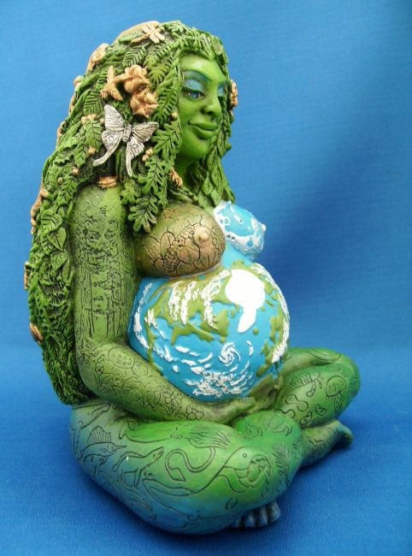
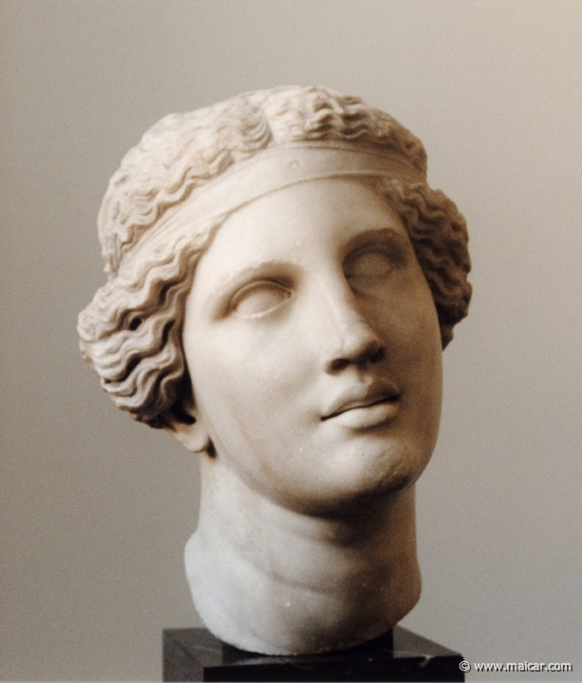
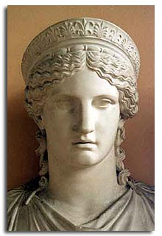
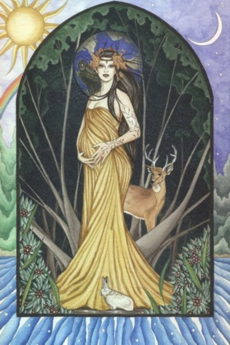
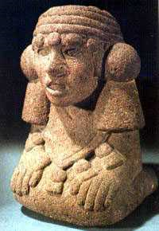
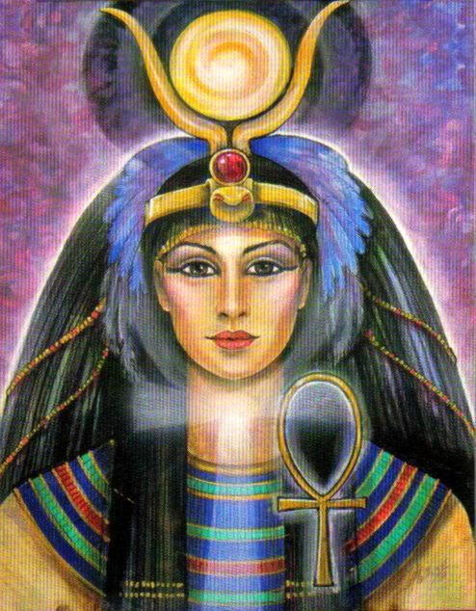
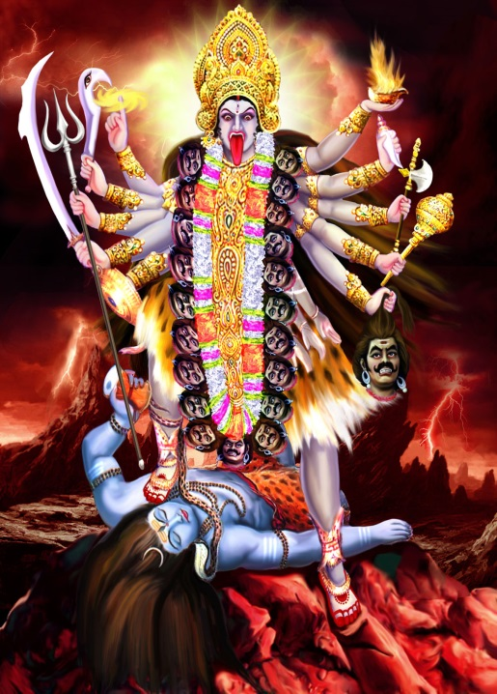
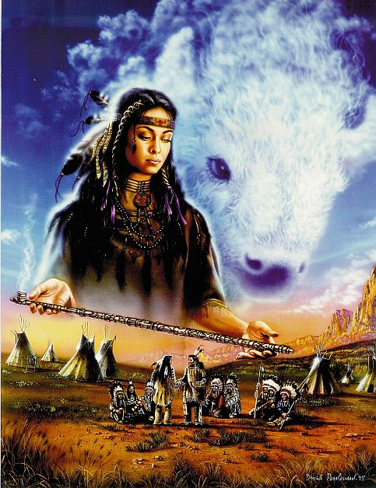
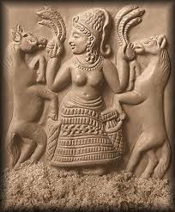
Gaia ↑ Isis ↓ Ariadne ↑ Kali ↓ Juno ↑ White Buffalo↓ Danu ↑ Ishtar ↓

Slide 11
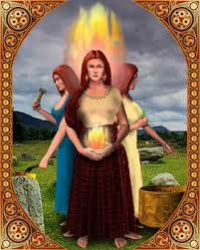
Ancient Irish Goddesses
In ancient Ireland, the fertility goddess was an important feature of the culture.
Danu was the mother-goddess of the Tuatha De Danann
Eriu was the land goddess of the Tuatha de Danann. (This is where Eire gets her name.)
When the Celts arrived they were equally committed to the worship of the goddess.
Devotion to pre-Christian Brighid was practised widely by the Celtic peoples.

Slide 12
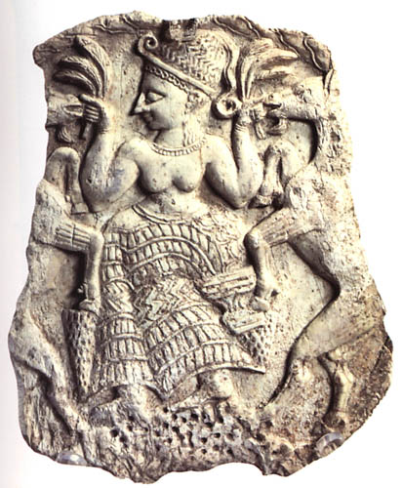
Waning of Devine Feminine
The Numinous (deity) was perceived as feminine until the emergence of the Neolithic-village cultures about 10 thousand years ago.
The change from hunting and gathering to agrarian life in fixed communities was to have profound consequences.
The age of Patriarchy took hold. Male gods dominated the heavens, & Kings, Warriors, Priests came to dominate the social and cultural domain on Earth.

Slide 13
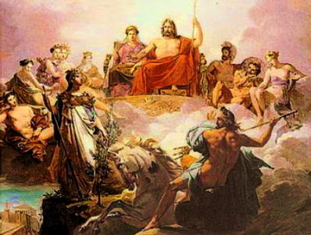
Greek Pantheon

Slide 14
The Rise of Male Gods
With the emergence of settled agrarian communities, Gods as well as goddesses become part of the Cosmic Story.
Having settled and tilled the land, defending it, and its produce, against roaming hunter gatherers was an absolute imperative.
Warriors were needed to defend the land and its crops, and later to subdue rivals.
Patriarchal societies emerge with appropriate warrior gods to bless their endeavours in defence and conquest.
The female goddesses did not disappear but the dominance of the divine feminine gave way to masculine warrior gods.

Slide 15


Slide 16
Emergence of Christianity
The first century of the new millennium witnessed the birth of Jesus and the emergences of the Christian tradition.
In the wake of the Crucifixion, the Jesus Movement remained a Jewish phenomenon.
With the fall of Jerusalem in 70 AD, and the destruction of the Second Temple, the religious atmosphere in Jerusalem changed utterly.
The followers of Jesus were banned from the synagogues, and began to evolve into a new religious movement beyond Judaism. They were soon to be called Christians. Acts 11:26 (Antioch)
The new movement opened its portals to the whole world, acquired a strong Greek influence, and quickly spread across to Rome.

Slide 17
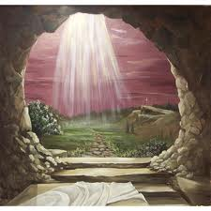
He Is Risen

Slide 18
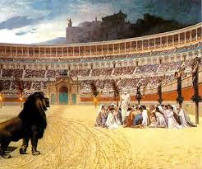
Roman Colosseum

Slide 19
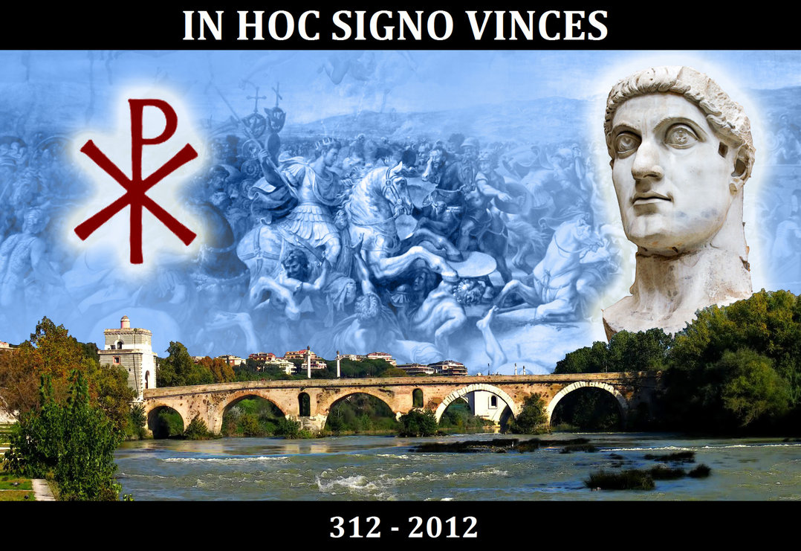
Battle of Ponte Milvio 312
Notes:
Maxentius

Slide 20
Christianising Earlier Traditions
When Constantine issued the Milan Edict in 313 AD, Christianity became the official religion of the Empire.
Constantine believed that One God, One Emperor, and One Religion would make for a more coherent empire.
The Milan Edict did not bring about an instantaneous change of local religions, customs and practice.
The policy adopted by the Church was to “baptise” local traditions by replacing nature worship with new Christian rituals.
With the spread of Christianity in the West, the sacredness of the Earth continued to permeate the religious & cultural life of the people.
Cultural traditions of a local area linger on with a life of their own; the superstitions associated with farming etc here in Ireland, for example.

Slide 21
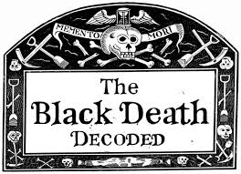

Slide 22
Change in Attitudes to Nature
In 1347 CE, the Great Plague arrived unannounced in Europe. People died in their thousands.
Between 1347 & 1353, one third of the population of Europe (over 25 million people) died.
There were several re-occurrences of the plague over the next five decades. By 1400 CE the European population was reduced by 50%.
People were terrified and saw it as Divine punishment. God was using Nature to punish his children.
People felt they had no redress against God, so the target of their resentment was focused on Nature.
People came to mistrust Nature regarding it as ‘a deceitful woman.’
Notes:
The classical period of witchhunts in Europe and North America falls into the Early Modern period or about 1480 to 1750, spanning the upheavals of the Reformation and the Thirty Years' War, resulting in an estimated 40,000 to 60,000 executio

Slide 23
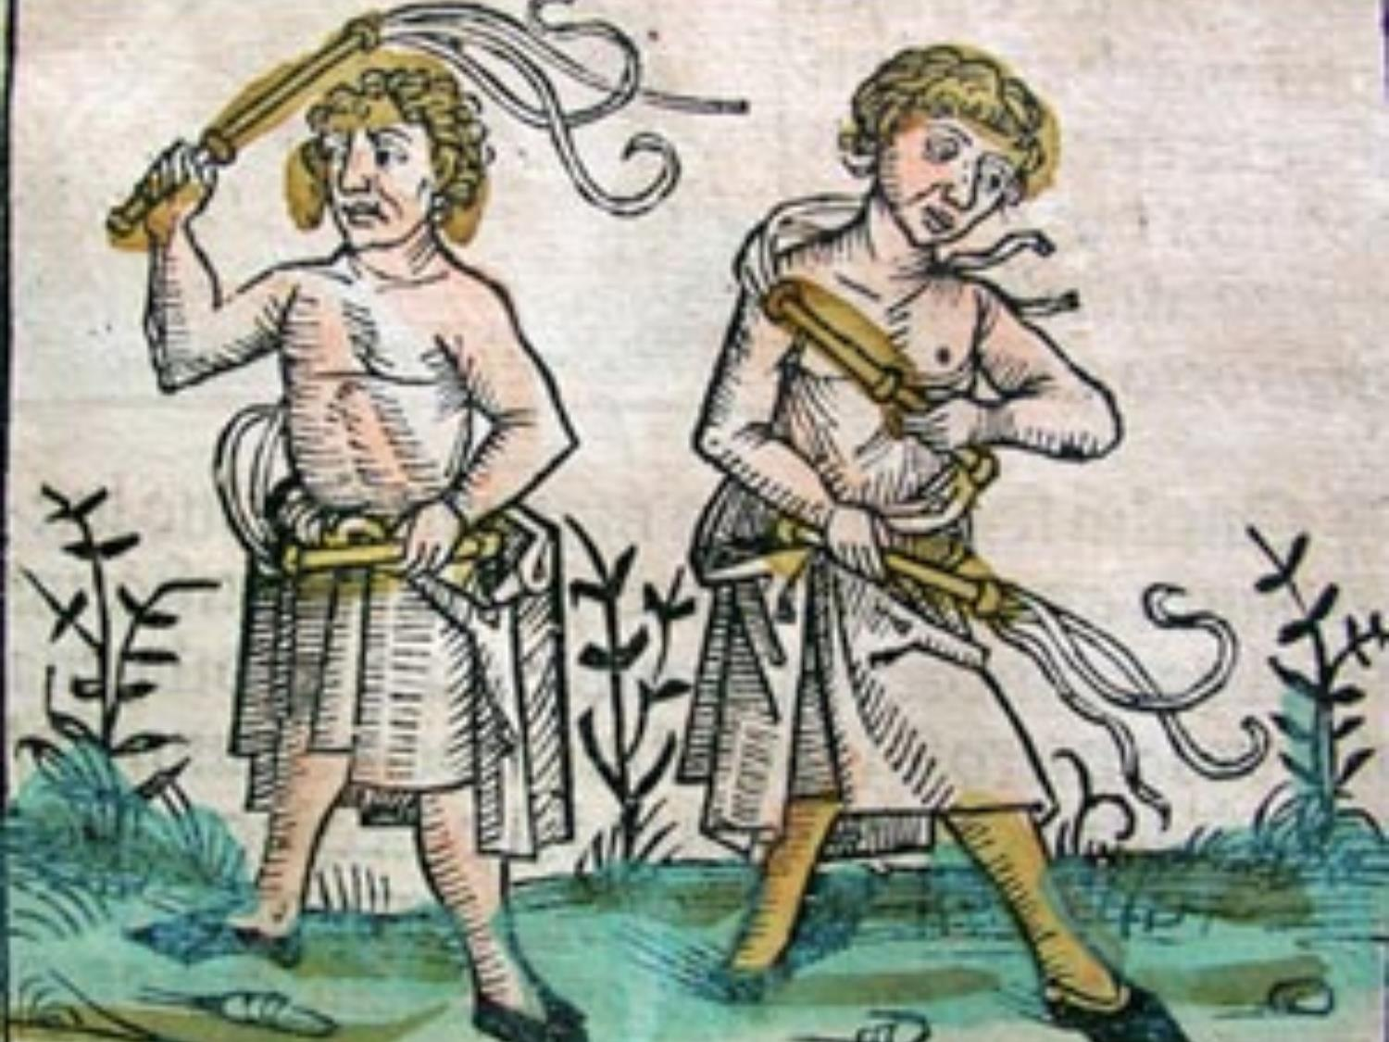

Slide 24
A World Gone Mad
The Plague gave rise to many irrational practices all across Europe. In many places, particularly in Germany, the Jews were held responsible for the plague and were punished accordingly.
A group emerged called the Flagellants who indulged in self-flagellation. They linked their activity to the scourging of Jesus and saw themselves as appeasing the wrath of God.
Bands of flagellants swarmed across Europe whipping themselves in public, blaming the Jews on the one hand, and the clergy on the other.
It was a sad chapter in the life of Christian Europe and had profound consequences over the next few centuries.
Notes:
The plague arrived in Avignon in 1348. The Pope Clement VI protected by sitting in a large room surrounded by a ring of fire.

Slide 25
Tainted Spirituality (1)
The Black Death influenced the type of spirituality that emerged in Europe in the decades that were to follow.
The body was seen as a corrupting agent that endangered the destiny of the eternal soul. Bodily asceticism was encouraged to control the body’s unruly passions. (Greek Gnosticism)
God was experienced as an awesome, punishing power capable of unleashing terrible retribution on sinful people.

Slide 26
Tainted Spirituality (2)
The fires of hell filled the imagination of preachers and artists alike.
The natural world was permeated with destructive forces alien to humans. Nature was devious and not to be trusted.
Women were associated with the wiles of nature and punished accordingly.
Over the next 150 years, 50,000 women were burnt at the stake as witches.
Many of them were tortured to confess their “wickedness”.

Slide 27
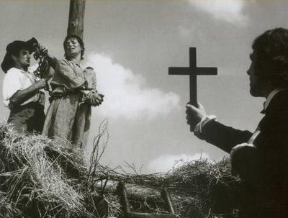

Slide 28
The Rise of Science
The first attempt to control the Earth was to invoke Magical power.
The second attempt to control the Earth was domination through human labour with the arrival of settled communities.
The third attempt to control the Earth was to invoke spiritual power appealing to the Divine for protection.
With coming of “The Enlightenment” science became the fourth attempt to control the Earth.
This movement got underway propelled by the inspiration of scientists like Copernicus, Kepler, Galileo, Descartes, Bacon and later on Newton.

Slide 29
Copernican Revolution
“He (Copernicus) snatches up the earth from the centre of the universe, sends her packing, and places the sun in the centre, to which it did more justly belong… All now goes round the sun, even the earth itself; and Copernicus to punish the earth for her former laziness, makes her contribute all she can to the motion of the planets and heavens; and now deprived of all the heavenly equipage with which she was gloriously attended, she has nothing left her but the moon, which still turns round her.”
Quoted in Death of Nature by Carolyn Merchant128 )

Slide 30
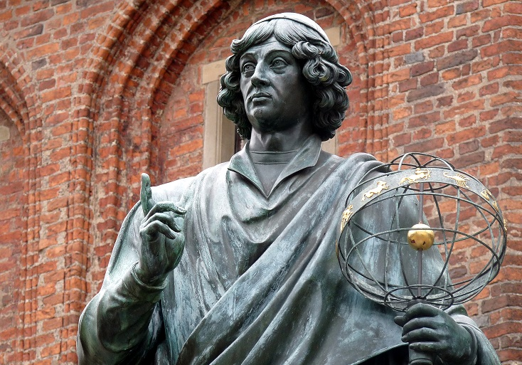
Torun Monument
Notes:
City of Torun

Slide 31
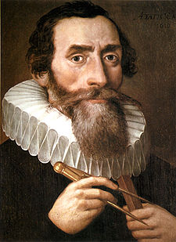
Kepler 1571 – 1630
Kepler was the successor of Tycho Brahe as Astronomer Royal to Holy Roman Emperor, Rudolph II.
Tycho had assembled a vast data bank of astronomical observations compiled over many years.
Kepler examined the data and deduced from them the laws governing the movement of planets.
The laws were called Kepler’s Laws.
Notes:
Orbits are ellipses
Equal Areas in equal intervals of time.
T squared is proportional to R (average) cubed

Slide 32
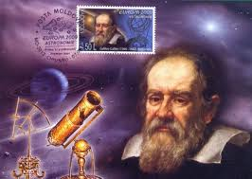

Slide 33
What Galileo Saw
In 1610 he published The Starry Messenger; an account of what he saw through his telescope.
Galileo became the first human being to see Jupiter’s moons, Saturn’s rings & sun spots.
He measured the height of the mountains on the moon from the length of their shadows.
In 1616 Galileo was charged with heresy by the Inquisition, headed by Cardinal Robert Bellarmine, but avoided condemnation.
He was a friend of Pope Urban VIII.
Notes:
Thanks to his intuition as a brilliant physicist and by relying on different arguments, Galileo, who practically invented the experimental method, understood why only the sun could function as the centre of the world, as it was then known, that is to say, as a planetary system. The error of the theologians of the time, when they maintained the centrality of the Earth, was to think that our understanding of the physical world's structure was, in some way, imposed by the literal sense of Sacred Scripture....
– Pope John Paul II, L'Osservatore Romano N. 44 (1264) - November 4, 1992

Slide 34
Galileo’s Trial
In 1632 Galileo published a book entitled Dialogue Concerning Two Chief World Systems:
The Sun-Centred World
v
The Earth-Centred World.
In 1633 Galileo was tried and condemned by the Inquisition for heresy (Joshua story)
He spent the rest of his days under house arrest.
In 1992, Pope John Paul II apologised for the trial and condemnation of Galileo.

Slide 35
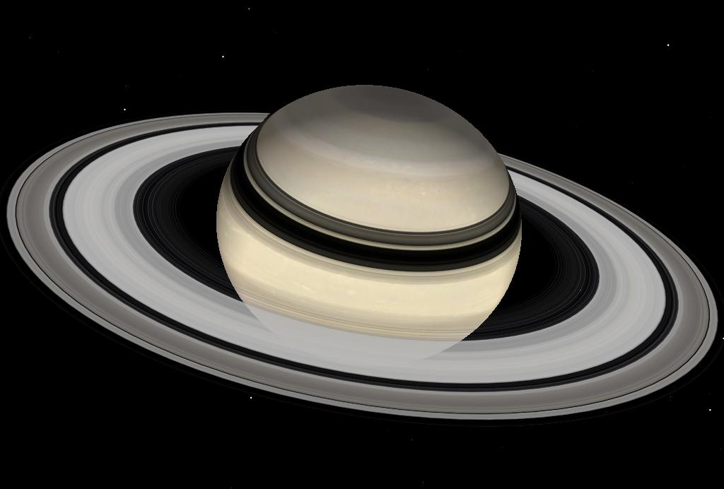
Planet Saturn

Slide 36
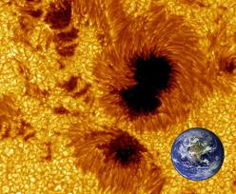
Notes:
Periodic – eleven year cycle

Slide 37
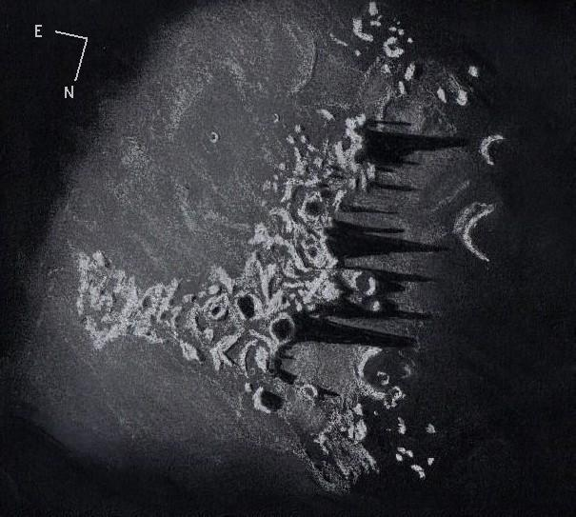

Slide 38
The Rise of Science
Science promised to control the power of Nature. (Making redundant any recourse to a Divine Power).
This attitude permeated the culture of the Enlightenment. Humans now saw themselves as being in control of their own destiny.
For them, Religion had become an anachronism.
Religion tended to see the scientific mind-set as rebellious, an attempt to wrestle from God the power to control the Earth. It was seen as the sin of pride, a repetition of the failure of Adam & Eve.
Like Prometheus, the scientists were trying to steal fire from heaven.
Science was also upstaging the power of the Church.

Slide 39
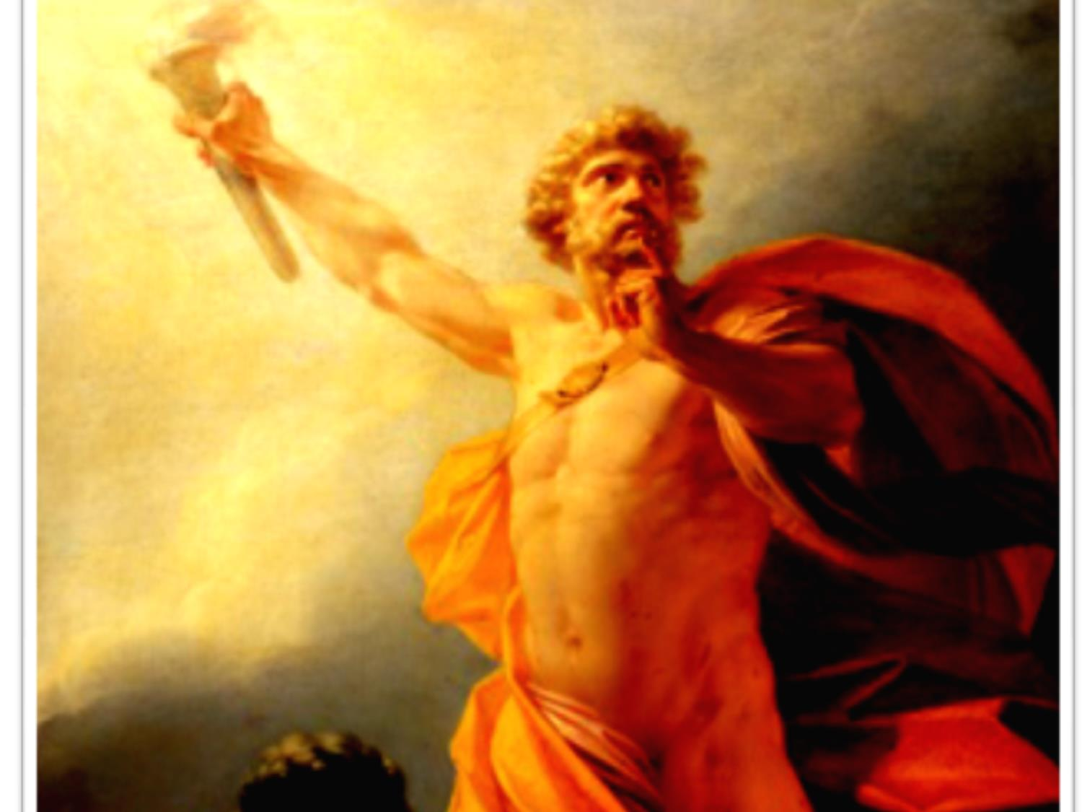
Prometheus

Slide 40
Descartes & Bacon
Rene Descartes on the Continent and Francis Bacon in England articulated the new approach to Nature.
Nature was a secretive, and spiteful enemy that had to be subdued and rendered powerless.
In order to do this Nature had to be “tortured” and forced to reveal her secrets, just like the unfortunate “witches”.
The goal was to exploit Nature’s secrets for the benefit and advantage of humans.
Science was seen as the tool that would give humans control over nature.
Nature itself becomes a great big treasury of resources to be plundered at human discretion.
Notes:
Merchant chapter 7

Slide 41
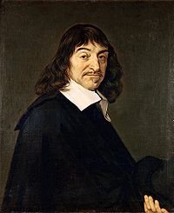
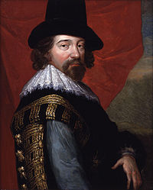
Descartes & Bacon
Philosophers of the New Science
Notes:
The New Atlantis of Francis Bacon - Science the New Religion – The scientist – the new priest Merchant p. 181 + Science was the way to return to man the power he lost through the Fall.. Merchant 185

Slide 42
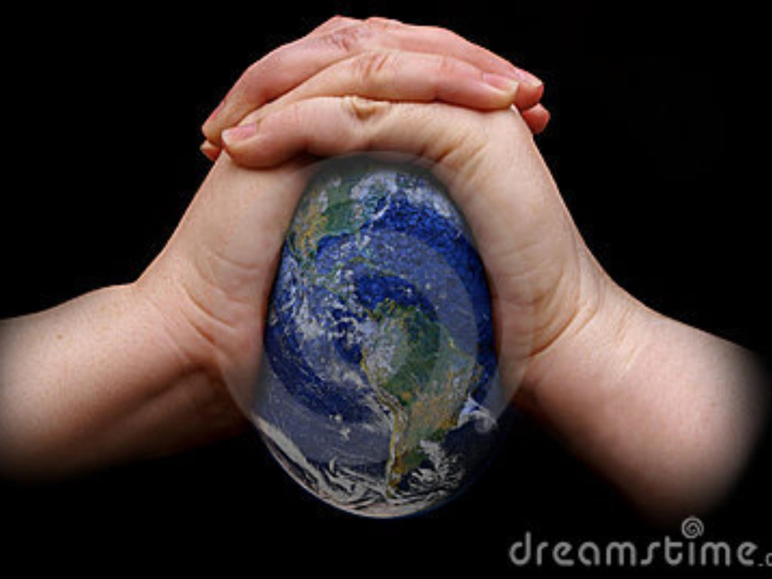
Squeezing Nature of Her Secrets

Slide 43
Enlightenment Culture
Enlightenment science drove a deep wedge between the spiritual and the scientific in terms of human knowledge.
Following the lead of Descartes, science focused its attention on “dead matter” and ignored the spiritual dimension. (Dualism)
With science came reductionism - we only get to understand things when we break them down into their constituent parts. Reductionism is still one of the fundamental beliefs of science.
Religious belief came to be seen as a fossil from a bygone, less enlightened, age.
Religion had no place in an enlightened society.
Notes:
John Locke (1561 – 1626) introduced the phrase “secondary phenomena” to describe religious experiences (epiphenomena) In 1619 Rene Descartes dreamed of Earth a great machine.

Slide 44
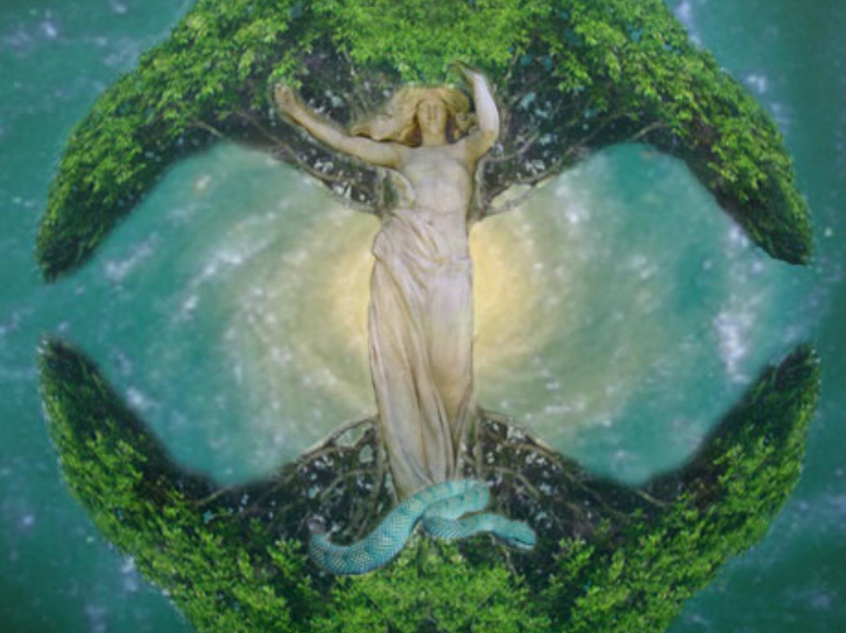
The Earth itself had become a scientific object without a soul. Plato’s Anima Mundi had evaporated.

Slide 45
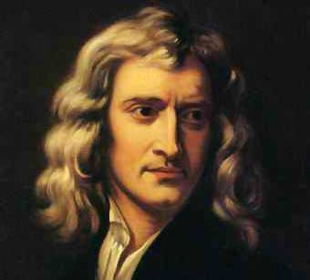
Nature and nature’s laws lay hid in night
God said, “Let Newton be!” and all was light.
Alexander Pope

Slide 46
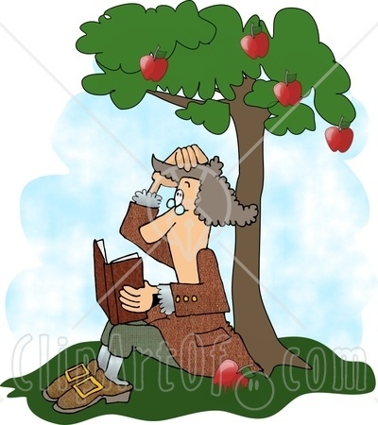
Newton’s Machine Universe
Newton discovered the Universal Law of Gravitational Attraction. In 1686 he published “Principia” with the famous
equation F = GMm/r²
He derived Kepler’s Three Laws of Planetary Motion from the Law of Gravitational Attraction.
Newton was confident that his Law could account for the behaviour of all of the heavenly bodies.
In applying his equations, all Newton needed to know were the conditions that prevailed at any particular time.
Notes:
Philosophiae Naturalis Principia Mathematica 1686
Kepler’s Laws Orbits are ellipses; Equal areas sewept out in equal time intervals’: T² is proportional to r³

Slide 47
Newtonian Universe
According to Newton, the Universe is a great big machine, just like a clock.
Like a machine, the behaviour of the Universe is totally predictable given the starting conditions.
The only need for God in the process was the need to have someone to wind up the clock at the beginning, and then let it run on doing its own thing.
In this scenario, Enlightenment Science replaces God in providing rational explanations for Nature’s mysteries.

Slide 48
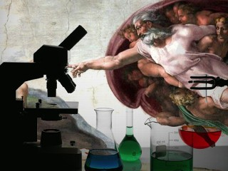
Consequences
Science or God

Slide 49
Age of Enlightenment
The emergence of secular science, freed from the shackles of religious dogma, gave rise to a powerful sense of hubris in Western secular society.
Science would provide the answer for all of human needs, and would provide answers for all of its unanswered questions.
Events like the Bubonic Plague would be a thing of the past.
Human hubris & arrogance were the defining quality of the Enlightenment Era.
Technology blossomed, and industrial barons exploited the resources of the Earth with frenzied enthusiasm.
Among the new elite, religion came to be regarded as superstitious nonsense.

Slide 50
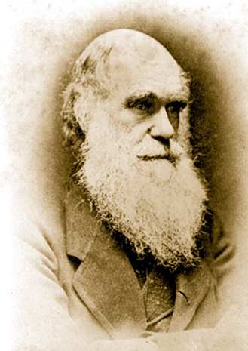
Theory of Evolution
In 1859, Charles Darwin published his famous book “The Origin of Species by Means of Natural Selection”.
This volume had a profound effect on science, religion and cultural generally.
For secular science, it was the final nail in the coffin of religious belief.
Death of God – The Will to Power -
Friedrich Nietzsche 1844 – 1900

Slide 51
Declining Status of Human
Copernicus removed the Earth from the centre of Universe replacing it with the sun.
Galileo’s telescope removed the sun from the centre of the Universe reducing it to the status of an average star in a galaxy called the Milky Way.
Darwin reduced the human from being the centre of all life to just another species recently arrived.
Hubble Telescope reduced the status of the Milky Way to just another galaxy among 500 billion+ galaxies in the vast expanse of the Cosmos.

Slide 52
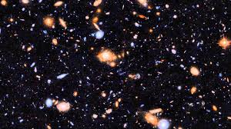

Slide 53
Disappearance of Sacred Earth
For thousands of years, humans lived with a sense of the sacredness of Nature.
The Earth was seen as nurturing Mother.
Throughout the Middle Ages, mining of the Earth was spoken of as the “ravishing” of Mother Earth.
The Black Death, the emergence of modern science, the culture & philosophy of the Enlightenment, and the rise of Industrial society changed all of that.
The sacredness of the Earth vanished, and Mother Earth was stripped of her dignity.
Earth was no longer a sacred place and became a resource for humans to exploit.

Slide 54
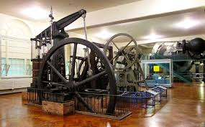
Jamie Watt’s Steam Engine

Slide 55
Industrial Expansion
With the availability of Watt’s steam engine, and a bountiful supply of fossil fuel, industrial production exploded.
There was not enough raw material to keep the steam engines busy, and the factories working at full tilt.
European powers embarked on a campaign of colonialism in Africa, India, South America and other unprotected regions of the Earth.
Colonialism was a way of syphoning wealth from poor countries to rich countries.
Africa also provided what was perceived as a new source of cheap labour in the guise of black slaves who were trafficked to the Americas in their thousands…

Slide 56
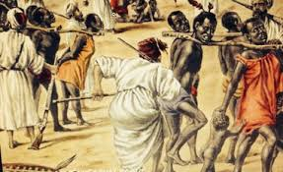

Slide 57
Rise of Industrial Mentality
Industrial mentality has no sense of the sacred:
Earth and all it contained was for the benefit of humans.
The resources of the Earth could be exploited without limit.
Earth’s ecosystems were unimportant. Earth’s non-human life was expendable.
There was no regard for, or cognisance of, the limited nature of Earth’s resources.

Slide 58
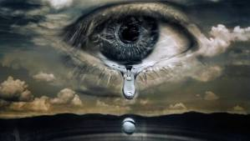
Earth Under Stress

Slide 59
Abuse of Mother Earth
It is 95% certain that Climate Change is human induced: IPCC Report 2013.3 (Intergovernmental Panel On Climate Change)
The current destruction of rain forests is 1 acre per second
The current rate of extinction of species is 20,000 per year
The pollution of the atmosphere: CO₂ at 0.04%
The degradation of fertile land: Over 75 billion tons of topsoil is lost per year
Loss of Antarctic ice cover: Thinning by 4 to 8 metres per year
Arctic Sea Ice was at an all time low in the summer of 2013.
The over-population of the Planet: From 1 billion in 1800 to 7.0 billion in the year 2011 and rising
Notes:
CF State of the World

Slide 60
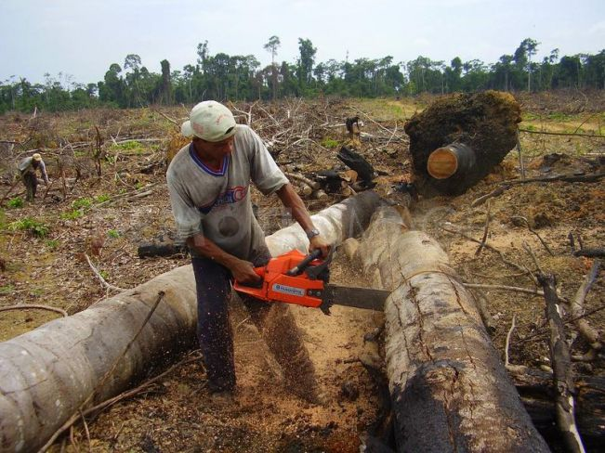
Amazonian Rain Forest

Slide 61
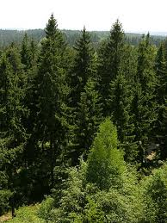

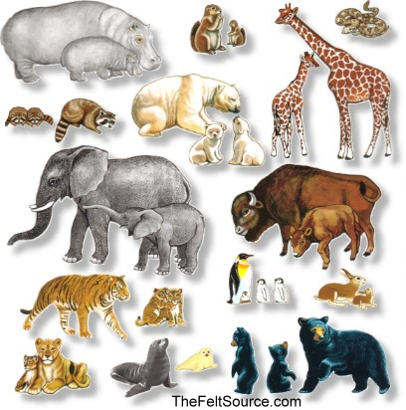


Slide 62
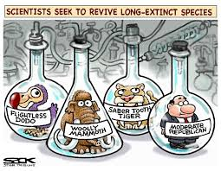

Slide 63
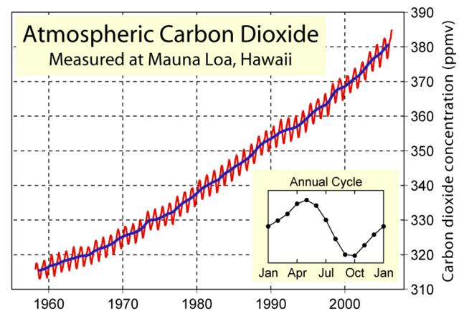
Carbon Levels in Atmosphere
Increase of 22.5% since 1965
Notes:
Keeling Curve

Slide 64
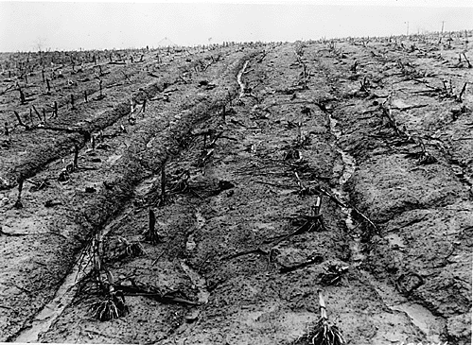
Vanishing Top Soil

Slide 65
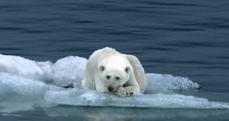
Melting Ice Cover

Slide 66
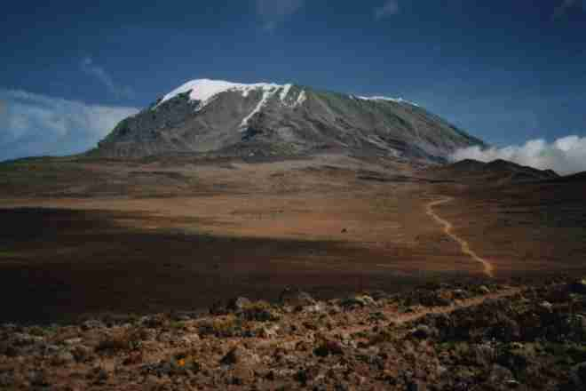
Snows of Kilimanjaro
2013

Slide 67
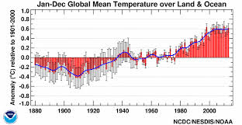


Slide 68
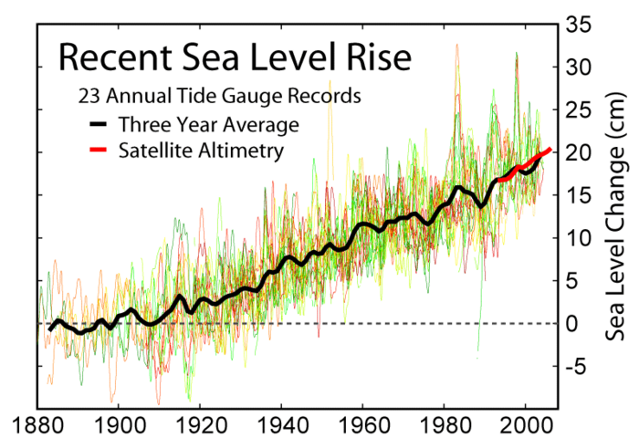
Since 1880, sea levels have risen by 20 cm/8 inches.

Slide 69

Post Sand Tar Oil Extraction

Slide 70
Care of The Earth

Slide 71
“How can we respect and preserve the environment that belongs as much to future generations as to the present? The ethical snare for the scientist is to get so caught up in the excitement of research that there is never time to ask where it is going and to what end. Not everything that can be done should be done.”
Polkinghorne, John (1998-03-30) Belief in God in an Age of Science

Slide 72
Theological Framework
In the prologue to John’s gospel, all of Creation is understood as the incarnation of the Divine.
This theological insight implies that every created thing is a sacrament of Divine Presence.
The poets and mystics have understood this for centuries.
Secular science has cultivated a mechanistic attitude to all of creation, regarding matter as dead without a sacred character.
It has led to the desacralization of the Earth and the plundering of Earth’s resources.
Wendell Berry calls this abuse of the Earth a Desecration.

Slide 73

Earth is Sacred
“The world is our meeting place with God ... as the body of God, it is wondrously, awesomely, divinely mysterious."
Sallie McFague. The Body of God

Slide 74
Earth’s Bioregions
Planet Earth presents itself as jigsaw of bioregions, each bioregion having its own distinctive geological formation, climatic conditions, and living forms.
These bioregions are dependent on the interplay of a variety of natural influences: climate, plant population, animal population, soil conditions etc. Left to their own devices they are self-sustaining.
When, for whatever reason, the balance of natural influences is disrupted, these bioregions will degenerate very quickly.
“The disruption of our bioregions is leading to a poisoning of the air we breathe, the water we drink, the soil and the seas that provide our food.”
Dream of the Earth Thomas Berry, p. 164

Slide 75

Chief Seattle
“This we know:
The Earth does not
belong to people.
People belong to the Earth.
This we know:
All things are connected.
Whatever befalls Earth,
Befalls the people of the Earth.
We did not weave the web of life.
We are but a mere strand in it.
Whatever we do to the web, we do to ourselves.”

