Slide 1
Holy Week

Slide 4
Sunday

Slide 5
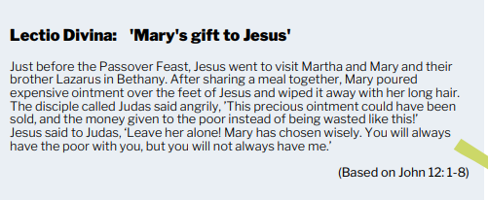
Monday

Slide 6
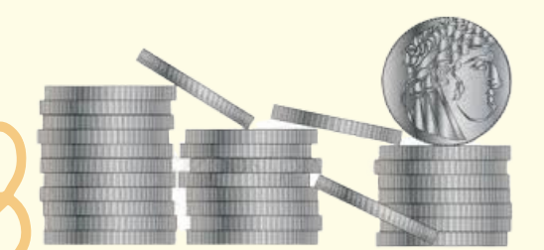
Tuesday

Slide 7
Wednesday

Slide 8
Thursday

Slide 9
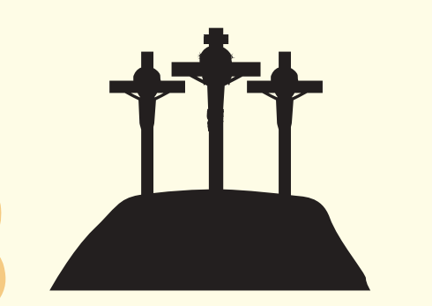
Good Friday

Slide 10
Holy Saturday

Slide 11
Easter Sunday

