Slide 1
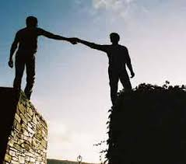
Forgiveness & Reconciliation

Slide 2
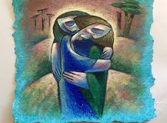
To live in peace means that we must be willing to forgive others
We must work towards healing any hurt that may have been done to us or others

Slide 3
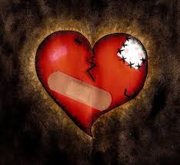
Forgiveness means letting go resentment and showing mercy to someone who has hurt you
Reconciliation means repairing a relationship after a disagreement or conflict

Slide 4
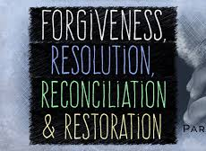
The main goal of forgiveness and reconciliation is not to undo the wrong or harmful action that was committed as it isn’t always possible
The goal is try to repair the hurt and damage caused and to move forward

Slide 5
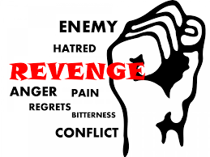
Can you think of any book, film or television show that has a plot about revenge?
Describe why the character in it wanted to get revenge.
Can you remember the outcome of the movie/tv-show/book?
Did the plot for revenge work?

Slide 6
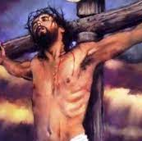
One of the most powerful examples of forgiveness can be found in the Gospel of Luke
Jesus is being crucified on Good Friday and he call outs to God to ask for forgiveness for those who are killing him “Forgive them, Father! They don’t know what they are doing”
The Lord’s Prayer- Our Father- ‘forgive us our trespasses, as we forgive those who trespass against us’

Slide 9
Questions
Why do you think Pope John Paul II asked Catholics to pray for Agca?
Why do you think the solider who shot Richard Moore never actually said sorry to him?
Does Richard think forgiving someone depends on them being sorry or saying sorry?
Do you agree with Richard?
Using the examples from both stories, explain how reconciliation and compassion are linked

Slide 10
Scientific Research
Scientific research has shown the benefits of forgiveness for:
People’s individual wellbeing
The wellbeing of society
People’s inner peace
Peace in the world

Slide 11
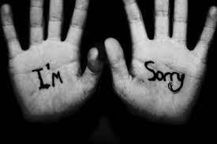
Forgiveness isn’t always easy
You might be inspired by stories of people finding the strength to forgive those who have shot them or killed their loved ones but you can still struggle to forgive others for things that are much less serious
Forgiveness isn’t something that comes easy
Shared human values such as empathy, mercy and compassion help people to forgive and the resulting reconciliation and inner peace are worth the struggle and effort

Slide 12
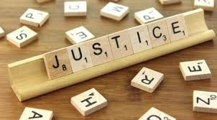
Justice
When a person forgives, it does not mean that they do not want justice
If a person has committed a crime, they should still be punished
When someone hurts us, we sometimes hold on to the hurt and anger for a long time
We can put a lot of energy into plotting our revenge or hoping for karma
Revenge is not the same as justice
Revenge involves hurting the person who has hurt us, whereas justice is about the fair treatment of everyone

Slide 13
Forgiveness is a gift you give yourself
It is worth remembering that when you forgive someone, it is more about you than it is about them
You can forgive others not because they deserve it, but because you deserve peace
Sometimes you choose to forgive someone because you still want them in your life
It is also possible to forgive someone and not allow them to be part of your life anymore
When you forgive, you are without carrying the weight of upset, hatred and anger
You may need to give yourself time to heal from the hurt, but things always get better with time

Slide 14
Questions
Summarise what scientific research says about the benefits of forgiveness
List 3 human values that help people to forgive others
Does someone have to be sorry for what they have done before you can forgive them? Explain you answer

