Slide 1
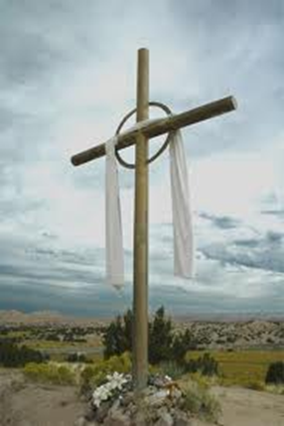
Second Week of Easter
John 20:19-31

Slide 2
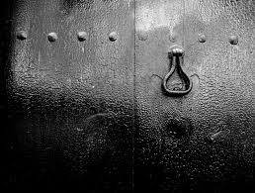
.’…the doors were closed in the room where the disciples were…’

Slide 3
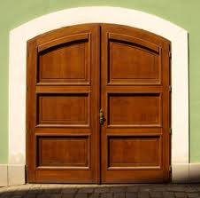
Sometimes the doors of my heart are also closed….

Slide 4
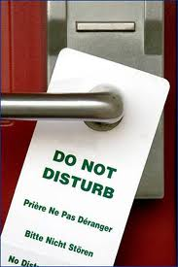
…and I refuse to be disturbed by anyone or anything…
…but…
… being a Christian means the message of Jesus must disturb me…and challenge me to love others as God loves them.

Slide 5
Lord…teach me to keep the doors of my heart open to You and to Your Truth and Goodness in every person I meet

Slide 6
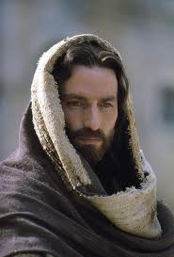
Jesus came and stood among them and said
“Peace be with you”
and showed them his hands and his side

Slide 7
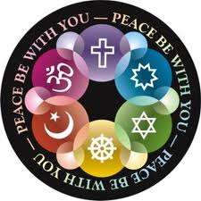
Lord…help me to be a person who brings peace to everyone I meet
Let my thoughts be of peace
Let my words be of peace
Let my actions be of peace

Slide 8
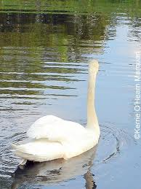
Let the doors of my heart
be open to God’s peace
Let the peace of God
be reflected in my life

Slide 9
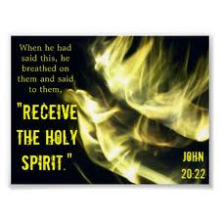

Slide 10
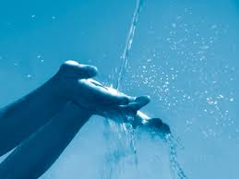
Lord, let me receive you into my heart every day

Slide 11
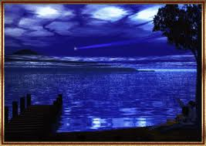
Lord, help me to trust that you are the Light in the darkness around me

Slide 12
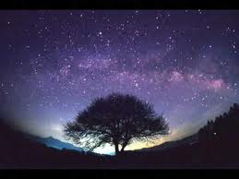
You alone are the Holy One, You alone are the Lord.
Your greatness is all around me
and within me

Slide 13
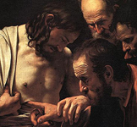
"Unless I see the nail marks in his hands and put my finger
where the nails were,
and put my hand into his side,
I will not believe it."

Slide 14
Then Jesus said to Thomas,
"Put your finger here;
give me your hand
and put it into my side.
Stop doubting and believe."

Slide 15
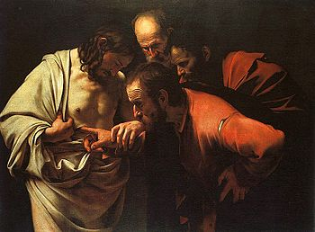

Slide 16
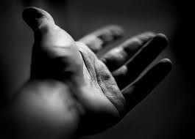
“Give me your hand”
This is the invitation of Jesus to me.

Slide 17
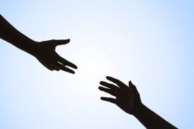
Will I open my hand to the God of Love?

Slide 18
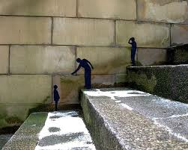
Will I open my hand to help someone today?
Will I open my hand to bring Truth and Hope to someone today?

Slide 19
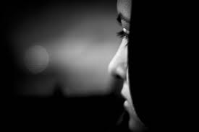
“Doubt no longer but believe”

Slide 20
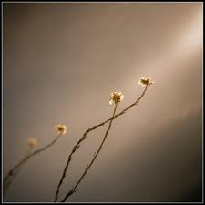
Lord, help my unbelief.
Help me to reach out to You
and be a person of hope for others.

Slide 21
Thomas said to him,
"My Lord
and my God!"
And Thomas believed...

Slide 22
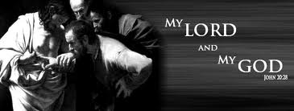

Slide 23
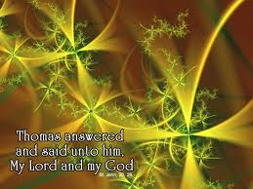

Slide 24
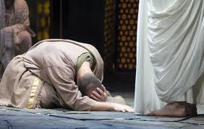

Slide 25
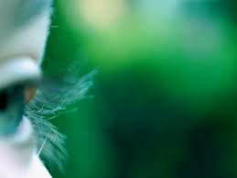
In every person I meet help me to honour You
as my Lord
and my God

Slide 26
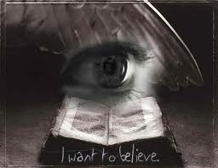

Slide 27
Happy are those who have not seen and yet believe

Slide 28
Happy are those who have not seen and yet believe

Slide 29
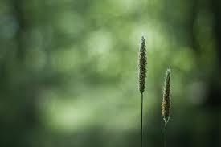
…so that you may believe that Jesus is the Christ, the Son of God,
and that believing this you may have life through His name.

Slide 30
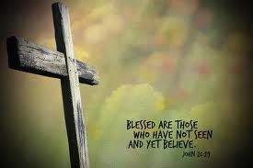

Slide 31
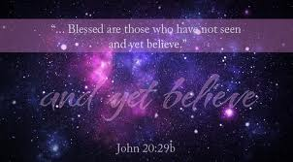

Slide 32
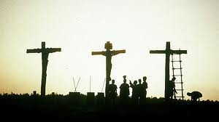
Lord, sometimes it’s hard for me to believe…

Slide 33
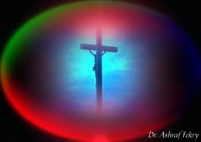
Open the doors of my heart to Your infinite love for me

Slide 34
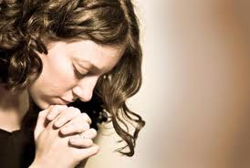
Help me to know You
in my innermost being

Slide 35
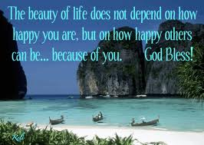

Slide 36
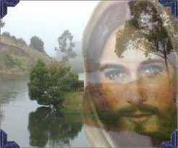
Happy are those who have not seen yet believe

Slide 37
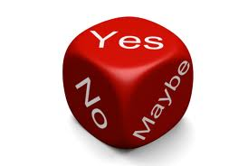
Do you believe that God loves you
and that Jesus’ resurrection from the dead
offers you the hope of everlasting life with God?

Slide 38
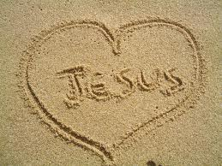
Never be afraid to proclaim your faith.
My Lord and my God

